Slide 1
Work and Power Notes

Slide 2
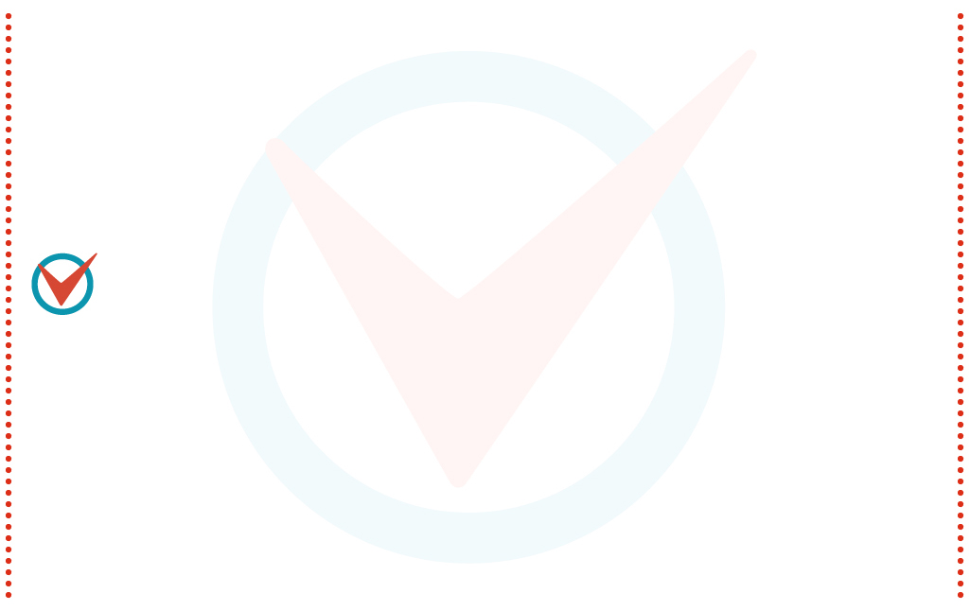
Work
Work is done when a net force acts on an object and the object moves in the direction of the net force.
Work is the product of the force on an object and the distance through which the object is moved: the quantity force × distance

Slide 3
Work
If the force is constant and the motion takes place in a straight line in the direction of the force, the work done on an object by a net force is the product of the force and the distance through which the object is moved.
work = net force × distance
W = Fd

Slide 4
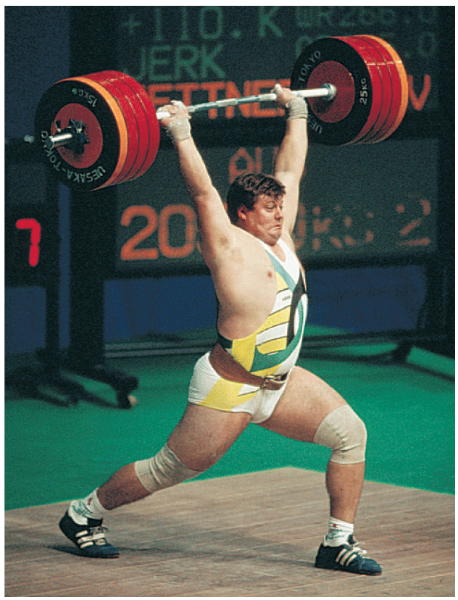
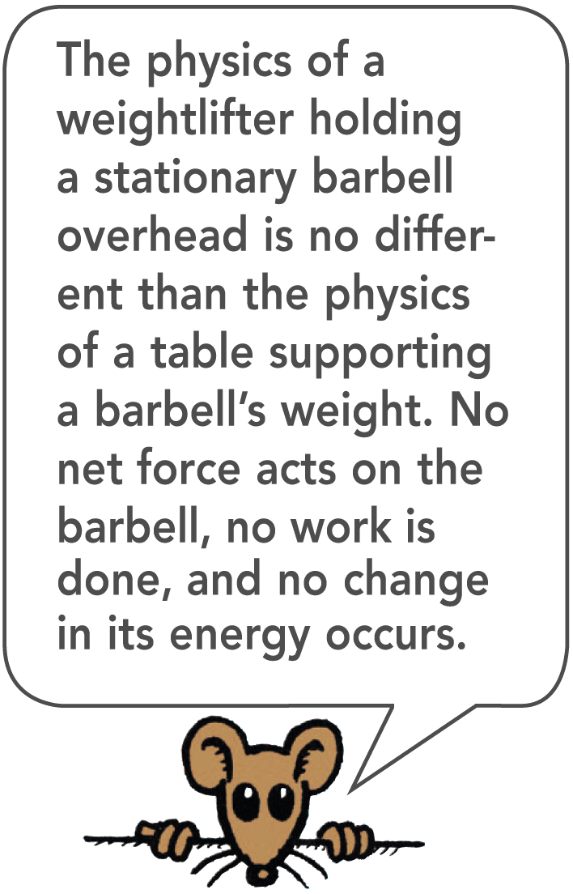
Barbell Example
Work is done in lifting the barbell. If the barbell could be lifted twice as high, the weight lifter would have to do twice as much work.
While the weight lifter is holding a barbell over his head, he may get really tired, but he does no work on the barbell.
Work may be done on the muscles by stretching and squeezing them, but this work is not done on the barbell.
When the weight lifter raises the barbell, he is doing work on it.

Slide 5
Work and Force
Some work is done against another force.
An archer stretches her bowstring, doing work against the elastic forces of the bow.
When the ram of a pile driver is raised, work is required to raise the ram against the force of gravity.
When you do push-ups, you do work against your own weight.

Slide 6
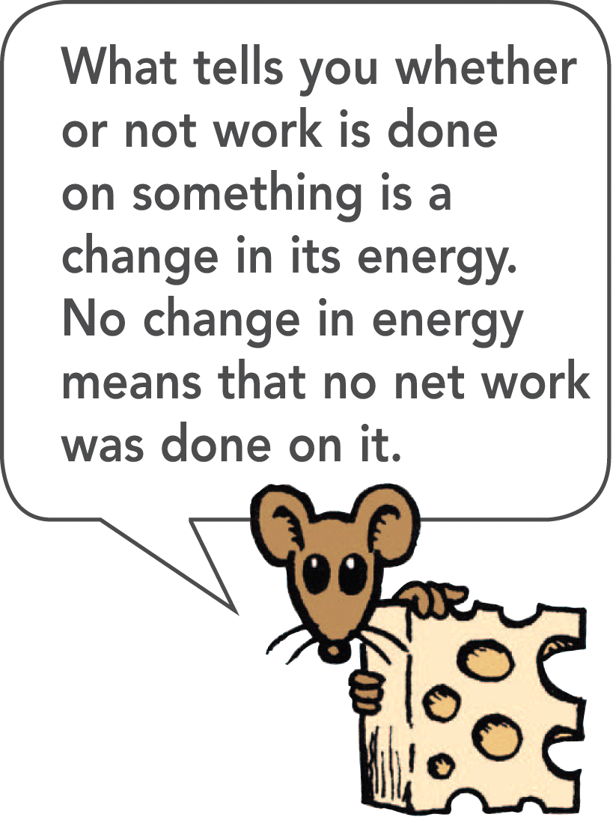
Work and Speed
Some work is done to change the speed of an object.
Bringing an automobile up to speed or in slowing it down involves work.
In both categories, work involves a transfer of energy between something and its surroundings.

Slide 7
Work Units
The unit of measurement for work combines a unit of force, N, with a unit of distance, m.
The unit of work is the newton-meter (N•m), also called the joule.
One joule (J) of work is done when a force of 1 N is exerted over a distance of 1 m (lifting an apple over your head).
Larger units are required to describe greater work.
Kilojoules (kJ) are thousands of joules. The weight lifter does work on the order of kilojoules.
Megajoules (MJ) are millions of joules. To stop a loaded truck going at 100 km/h takes megajoules of work.

Slide 8
think!
Suppose that you apply a 60-N horizontal force to a 32-kg package, which pushes it 4 meters across a mailroom floor. How much work do you do on the package?

Slide 9
think!
Suppose that you apply a 60-N horizontal force to a 32-kg package, which pushes it 4 meters across a mailroom floor. How much work do you do on the package?
Answer:
W = Fd = 60 N × 4 m = 240 J

Slide 10
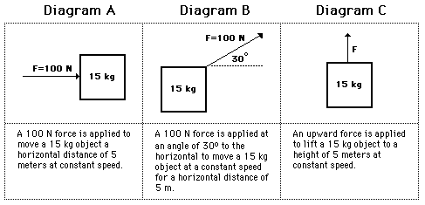
Work Practice Apply the work equation to determine the amount of work done by the applied force in each of the three situations described below.

Slide 11
Work Practice
Diagram A Answer:
W = (100 N) * (5 m) = 500 J
Diagram B Answer:
W = cos(30 degrees) *(100 N) * (5 m) = 433 J
Diagram C Answer:
W = (147 N) * (5 m) = 735 J

Slide 12
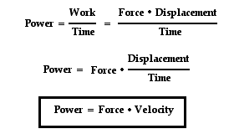
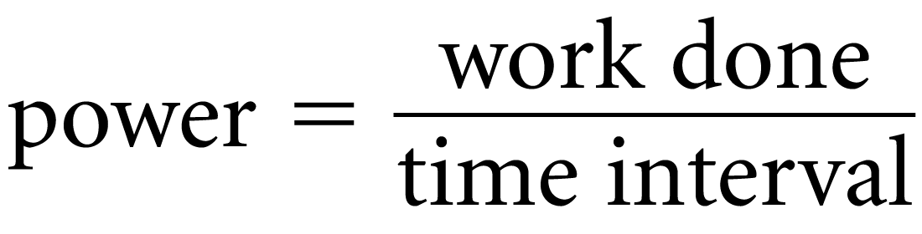
Power
Power equals the amount of work done divided by the time interval during which the work is done.
When carrying a load up some stairs, you do the same amount of work whether you walk or run up the stairs.
Power is the rate at which work is done.

Slide 13
High-Power Engine
A high-power engine does work rapidly.
An engine that delivers twice the power of another engine does not necessarily produce twice as much work or go twice as fast.
Twice the power means the engine can do twice the work in the same amount of time or the same amount of work in half the time.
A powerful engine can get an automobile up to a given speed in less time than a less powerful engine can.

Slide 14
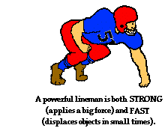
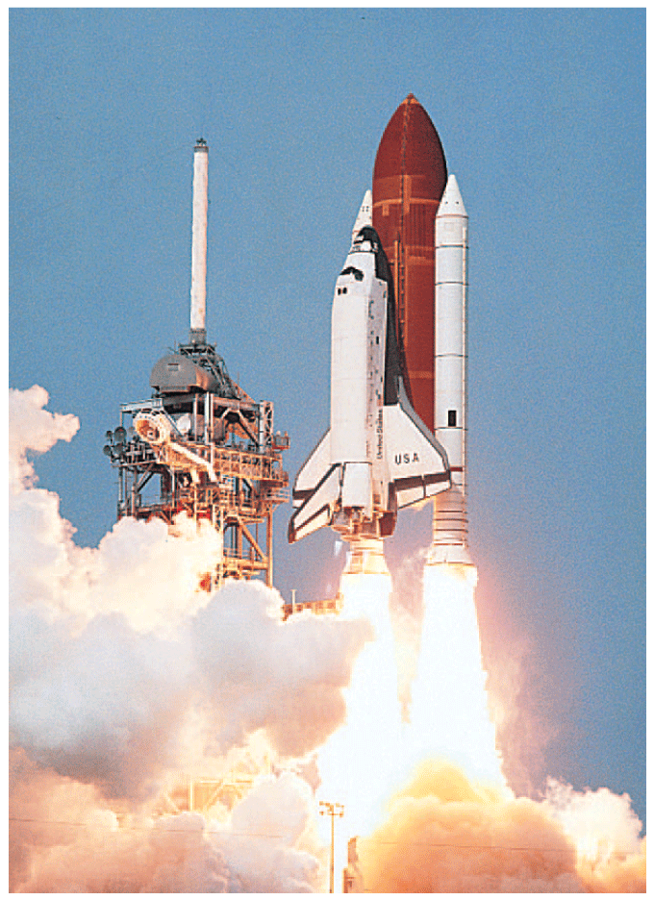
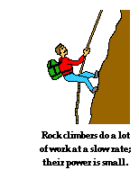
Power Examples
The three main engines of the space shuttle can develop 33,000 MW of power when fuel is burned at the enormous rate of 3400 kg/s.

Slide 15
Power Units
The unit of power is the joule per second, also known as the watt.
One watt (W) of power is expended when one joule of work is done in one second.
One kilowatt (kW) equals 1000 watts.
One megawatt (MW) equals one million watts.
In the United States, we customarily rate engines in units of horsepower and electricity in kilowatts, but either may be used.
In the metric system of units, automobiles are rated in kilowatts. One horsepower (hp) is the same as 0.75 kW, so an engine rated at 134 hp is a 100-kW engine.

Slide 16
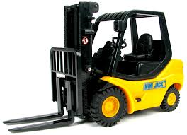
think!
If a forklift is replaced with a new forklift that has twice the power, how much greater a load can it lift in the same amount of time? If it lifts the same load, how much faster can it operate?

Slide 17
think!
If a forklift is replaced with a new forklift that has twice the power, how much greater a load can it lift in the same amount of time? If it lifts the same load, how much faster can it operate?
Answer:
The forklift that delivers twice the power will lift twice the load in the same time, or the same load in half the time.

